Slide 1

Predicting School Bus Delays: NYC Bus Breakdown and Delays Dataset

Slide 2
Project Overview
Dataset: NYC School Bus Breakdown & Delay Reports ( NYC Open Data)
Records: 1.22 million rows, 21 columns
Goal:
Predict delay duration (Regression) and classify delay severity (Low / Moderate / High)
Challenge: Data heavily unstructured and manually entered, required extensive cleaning and feature engineering
Outcome: Built a clean dataset and model pipeline to predict delays accurately and analyze key factors influencing them.
Notes:
Visuals… anal;yse data…

Slide 3
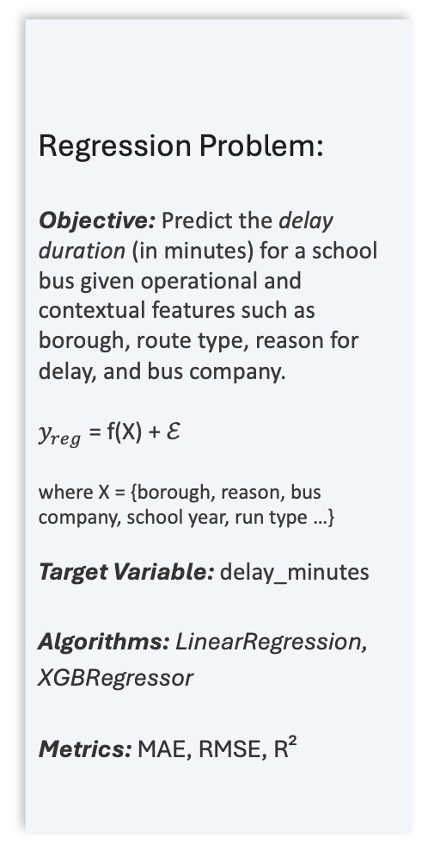
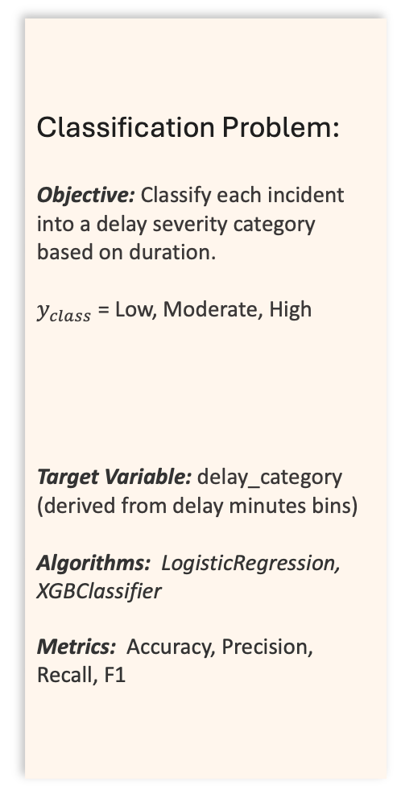
Problem Definition
This study explores two supervised learning formulations
to predict and classify NYC school bus delays.
Regression Problem:
Objective: Predict the delay duration (in minutes) for a school bus given operational and contextual features such as borough, route type, reason for delay, and bus company.
$y_{reg}$ = f(X) + ℰ
where X = {borough, reason, bus company, school year, run type …}
Target Variable: delay_minutes
Algorithms: LinearRegression, XGBRegressor
Metrics: MAE, RMSE, R²
Classification Problem:
Objective: Classify each incident into a delay severity category based on duration.
$y_{class}$ = Low, Moderate, High
Target Variable: delay_category (derived from delay minutes bins)
Algorithms: LogisticRegression,
XGBClassifier
Metrics: Accuracy, Precision, Recall, F1

Slide 4
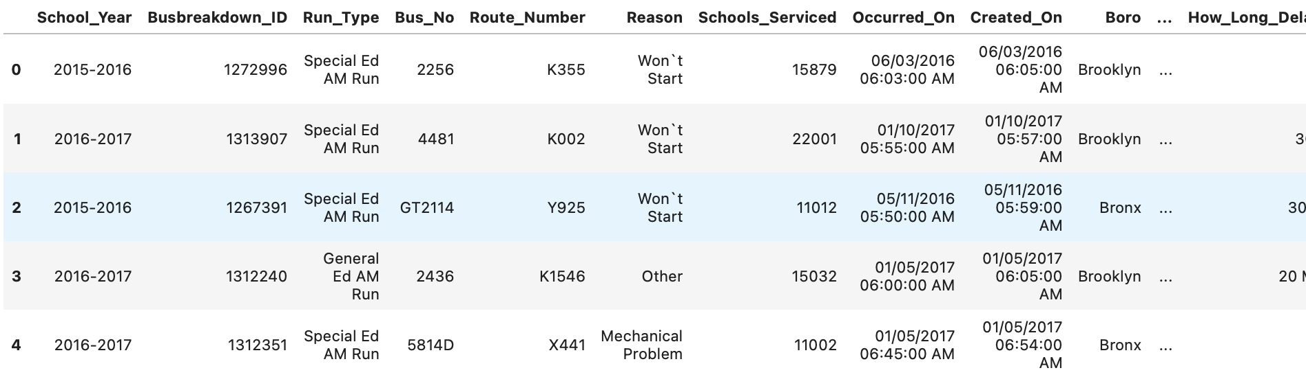
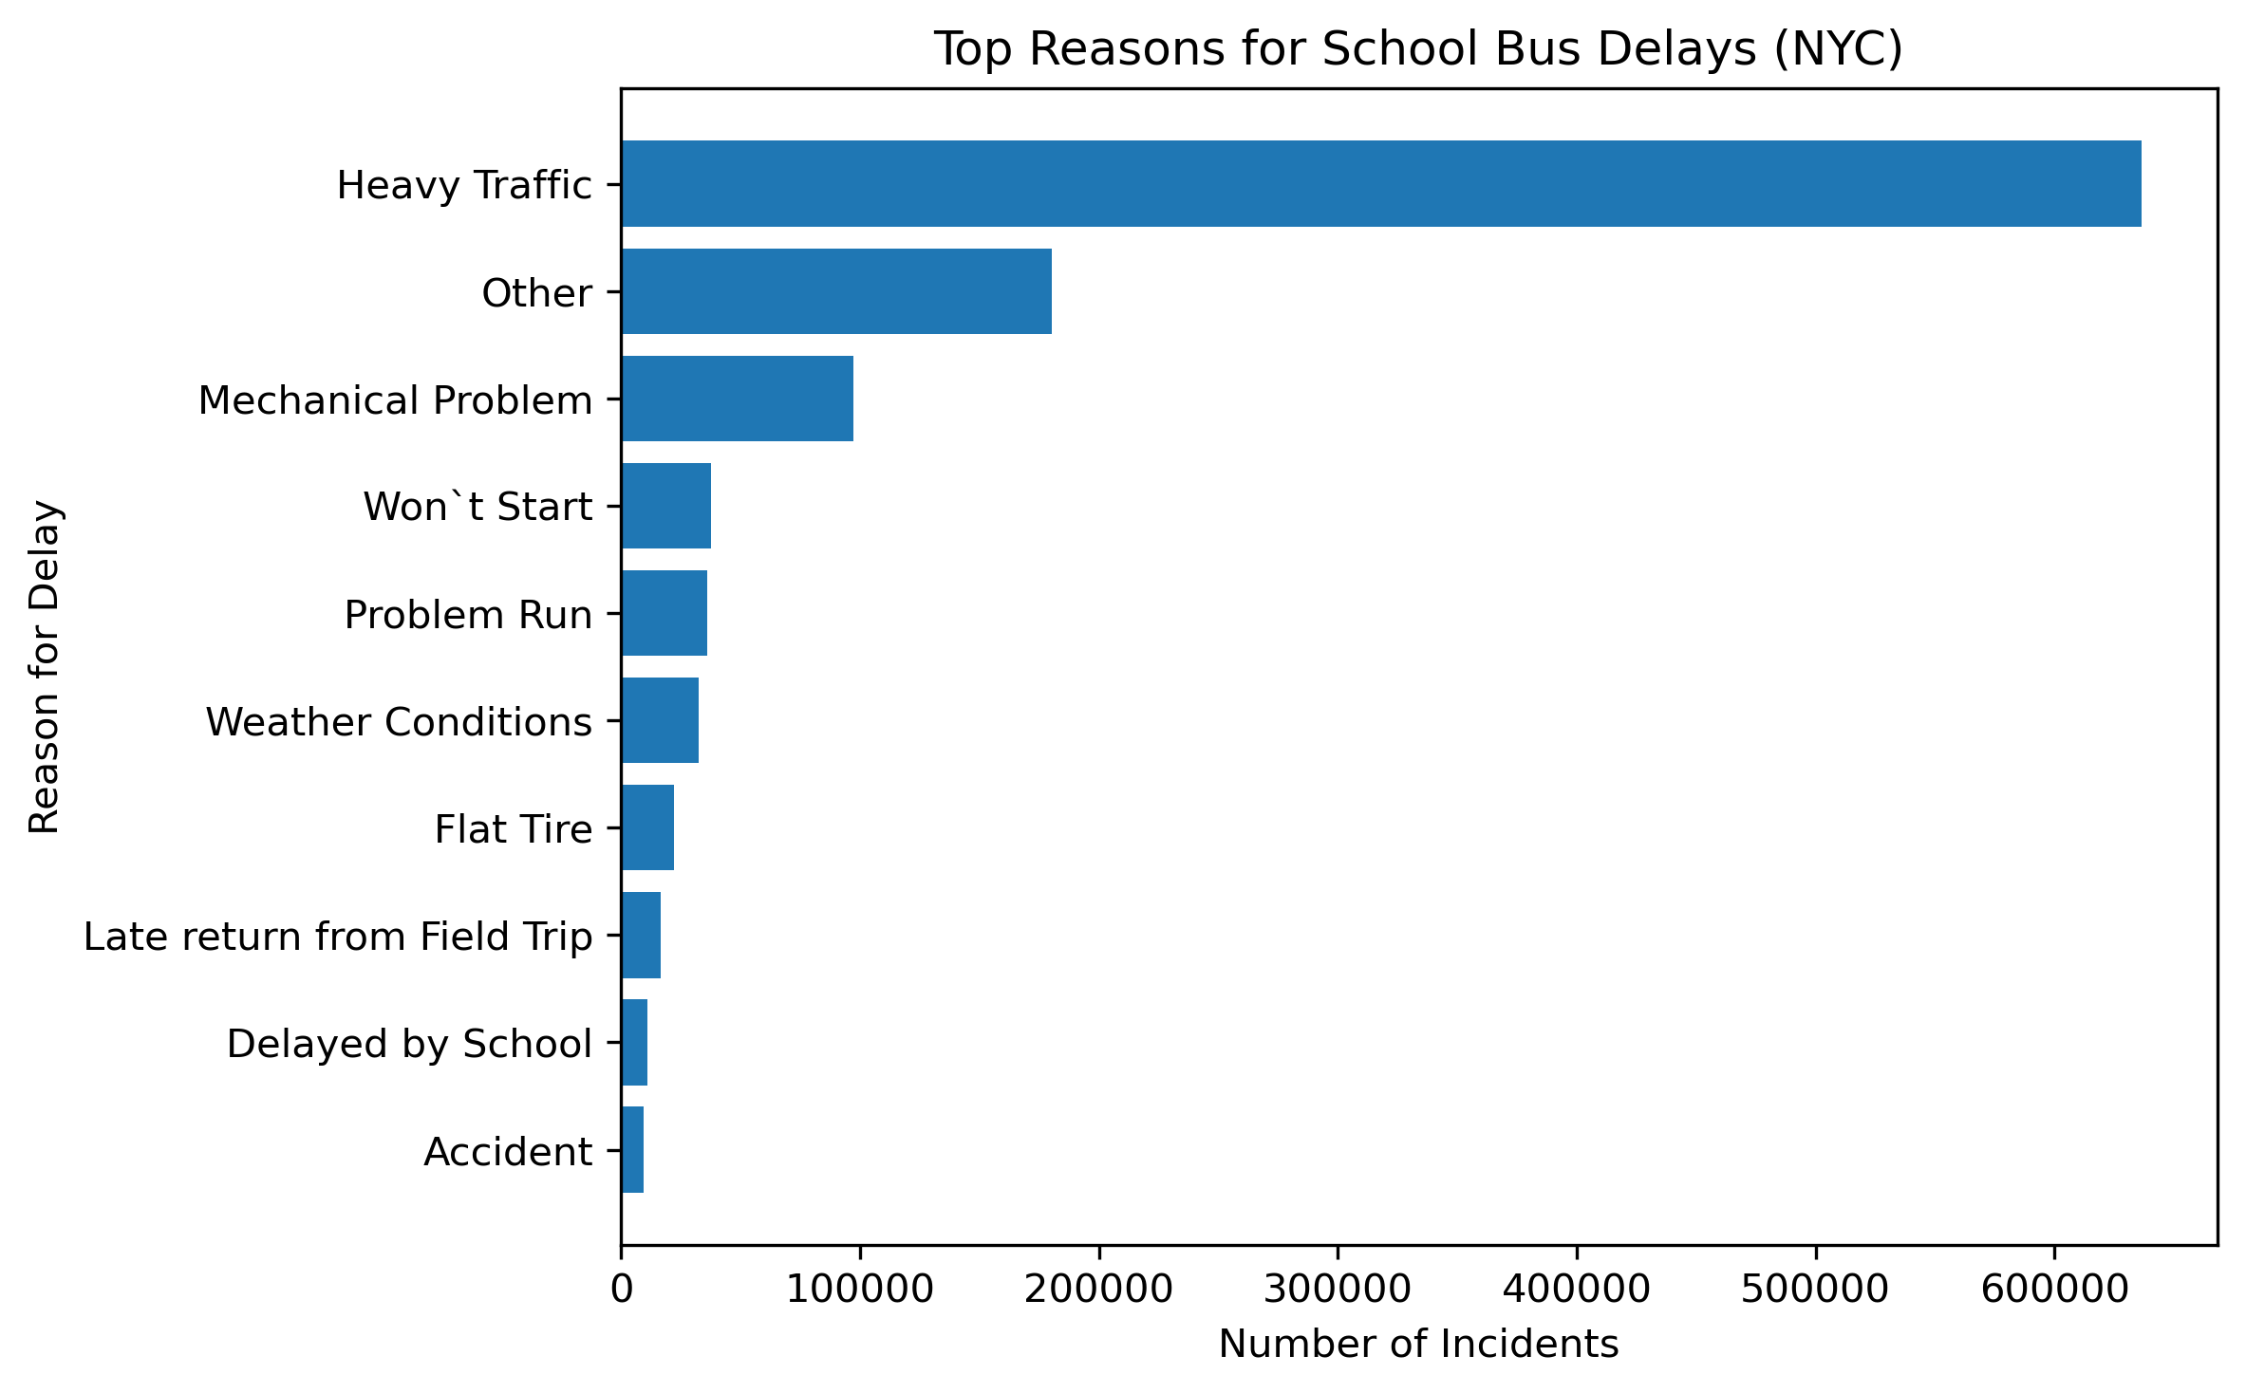
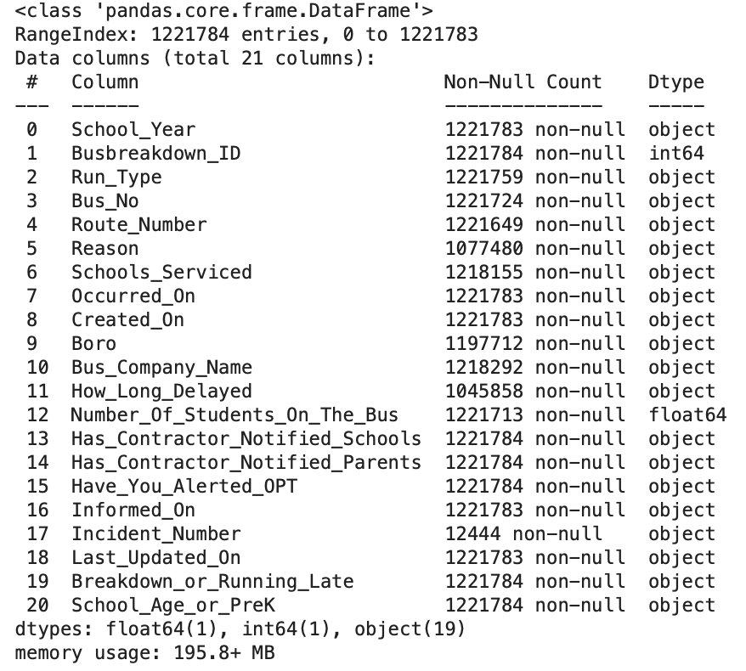
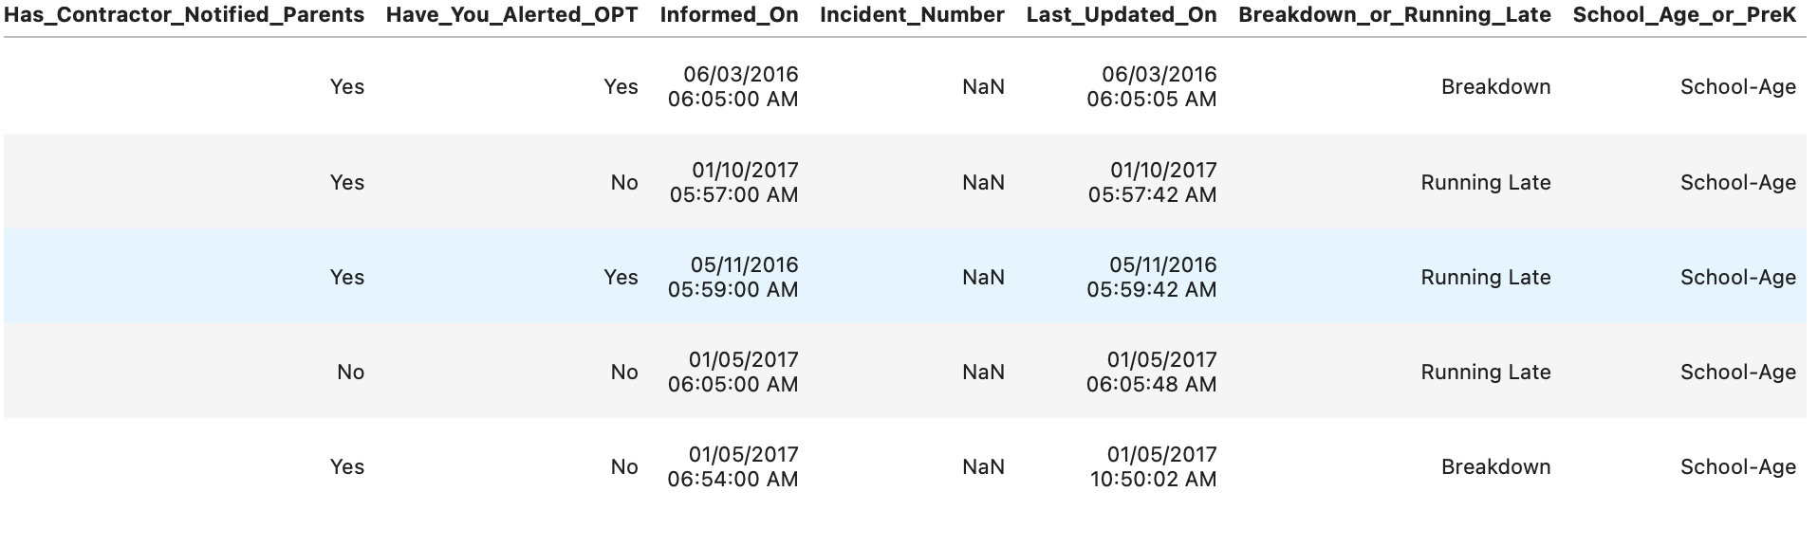
Dataset Overview
Exploring the raw dataset prior to preprocessing
Dataset pre cleaning: 1.22M rows × 20 columns

Slide 5
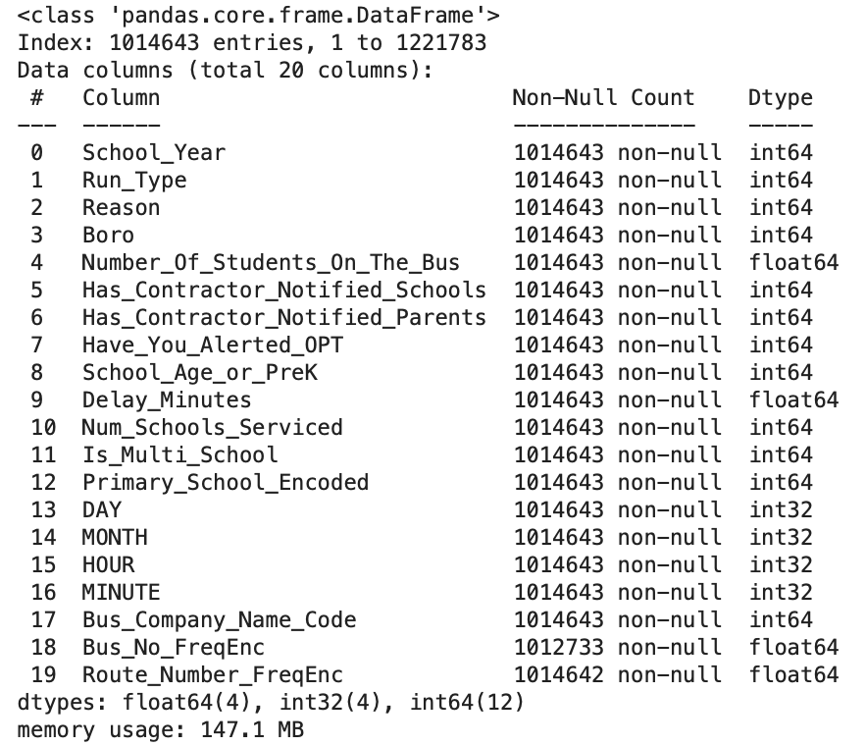
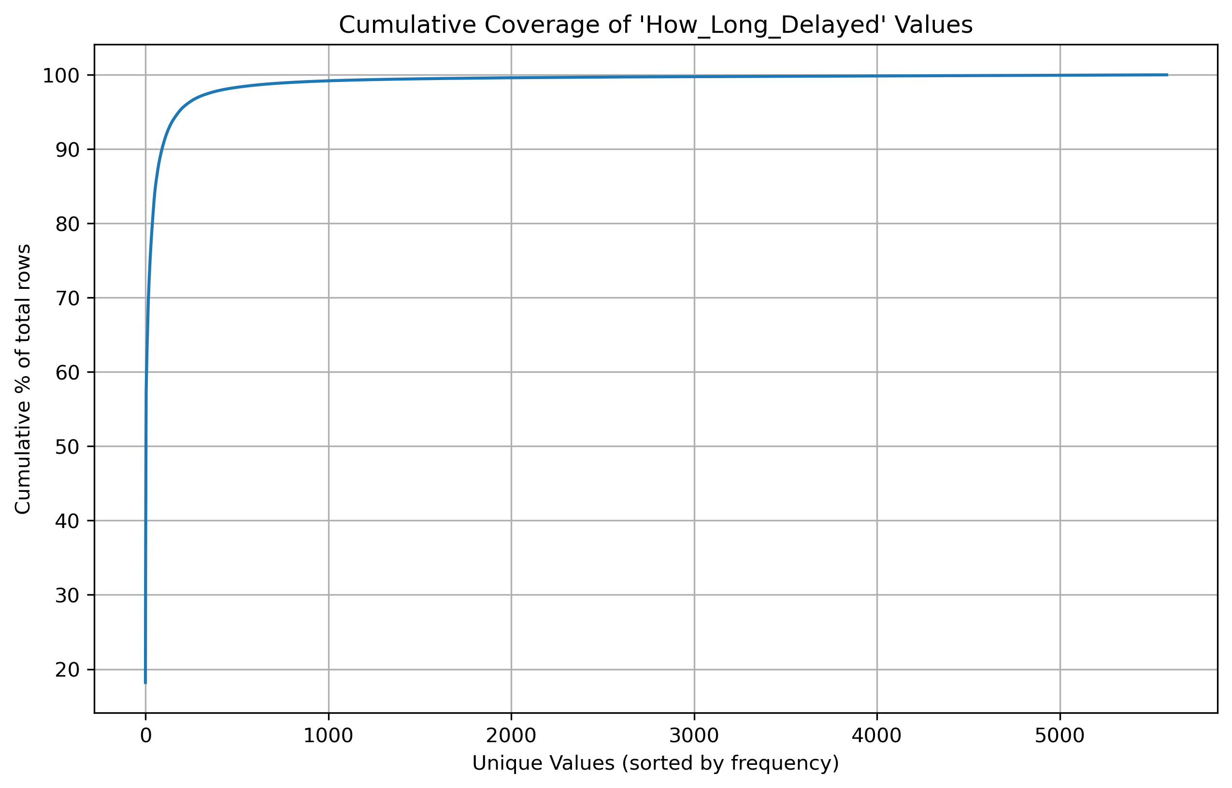
Data Preparation
Steps to clean, transform and structure the raw data for modeling
Dropped null-heavy (Incident_number) and redundant (Informed_on) columns → reduced noise
Standardized timestamps; extracted HOUR, DAY, MONTH → captures temporal patterns.
Cleaned delay text values using regex to extract numeric minutes → standardized target variable.
Normalized vendor names and removed unrealistic data (>80 students in a bus) → improved categorical quality.
# standardize delay and extract time features
df['Delay_Minutes'] = df['How_long_delayed'].str.extract(r'(\d+\.?\d*)').astype(float)
df['HOUR'] = pd.to_datetime(df['Occurred_On']).dt.hour
df = df[df['Number_Of_Students_On_The_Bus'] <= 80]
Final dataset after cleaning: 1.01M rows × 19 columns

Slide 6
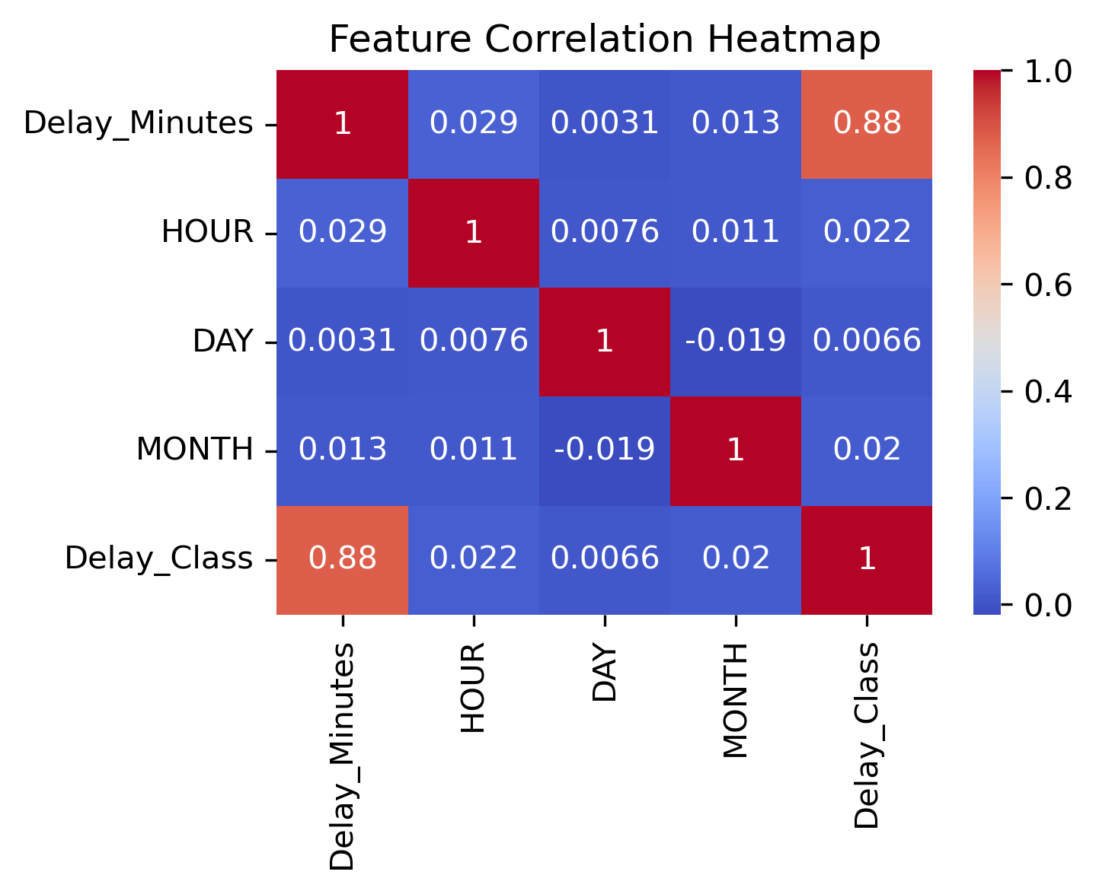
Feature Engineering
Deriving interpretable and predictive features from cleaned data for model readiness.
Feature Name | Purpose / Rationale
Delay_Minutes | Target variable - numeric delay extracted from text.
Delay_Class | Categorized delay level (Low / Moderate / High).
HOUR, DAY, MONTH | Temporal attributes capturing schedule patterns.
Bus_Company_Name_Code, Route_Number_FreqEnc | Frequency encoding reduces high-cardinality category expansion.
Num_Schools_Serviced, Is_Multi_School | Measures route complexity and operational dependency.
Primary_School_Encoded | Represents primary school association per incident.
# create delay class and encode categorical features
df['Delay_Class'] = pd.cut(
df['Delay_Minutes'],
bins=[-1, 20, 45, df['Delay_Minutes'].max()],
labels=[0, 1, 2]
)
freq_cols = ['Bus_Company_Name', 'Route_Number']
for col in freq_cols:
df[col + '_FreqEnc'] = df[col].map(df[col].value_counts())

Slide 7
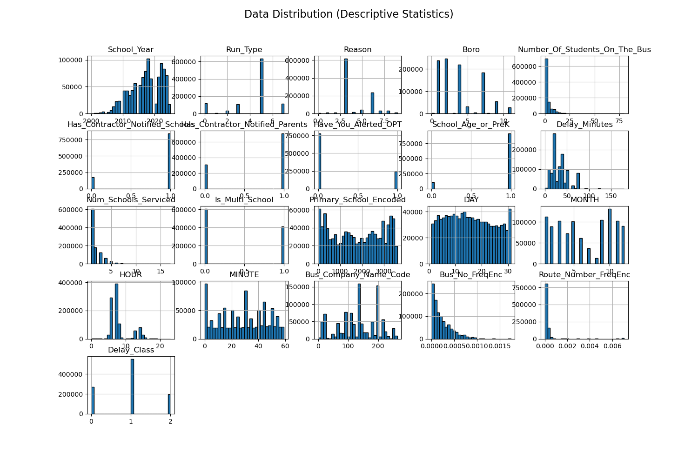
Exploratory Data Analysis Understanding delay patterns and influential factors before modeling.
Each subplot shows feature distribution after cleaning and encoding.
Skewed distributions indicate non-linear relationships suited for tree-based models.

Slide 8
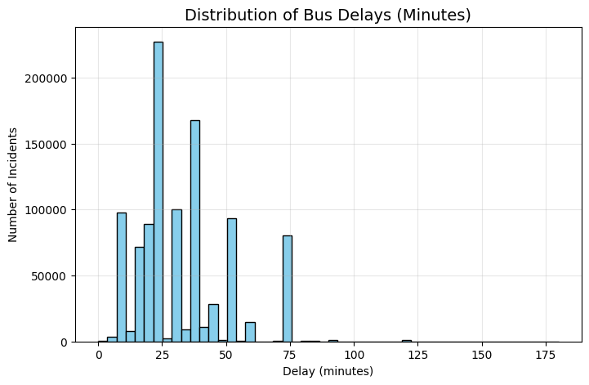
Delay Distribution Exploring delay duration patterns to define class boundaries. Most delays fall between 20–45 minutes. Defined delay classes: • Low ≤ 20 minutes • Moderate 21–45 minutes • High > 45 minutes Distribution is right-skewed → delays align with morning traffic peaks.
Figure 1. Distribution of Bus Delays (Minutes):
Most incidents cluster between 20–45 minutes, forming a right-skewed pattern that defines Low, Moderate, and High delay categories.
Insight: Delay durations follow a skewed distribution, validating categorical binning for supervised learning.

Slide 9
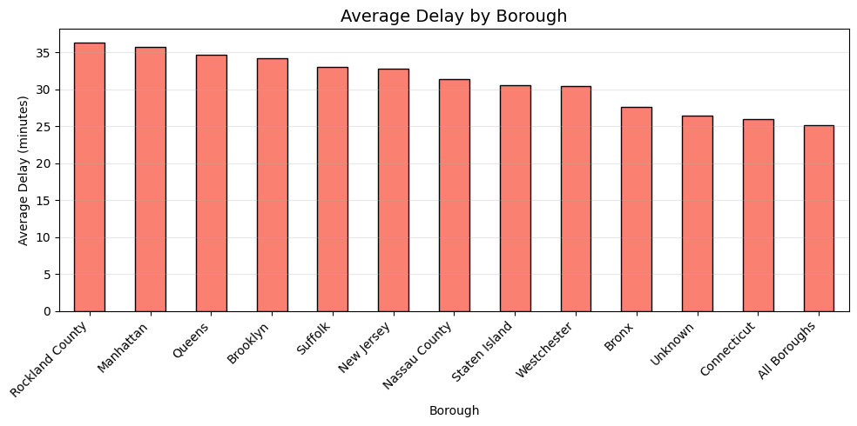
Delay by Borough Average borough-level delays reveal strong spatial variation. Top delay averages: • Rockland county → ~36 minutes • Manhattan → ~35 minutes • Queens → ~34 minutes Lowest delays observed in Staten Island and Westchester. Indicates congestion and route density influence delay severity.
Figure 2. Average Delay by Borough:
Rockland county and Manhattan record the highest mean delays (≈35–37 min), while outer boroughs show lower averages, highlighting route congestion and geographic constraints.
Insight: Borough-level patterns suggest congestion and route complexity directly affect bus delay times.

Slide 10
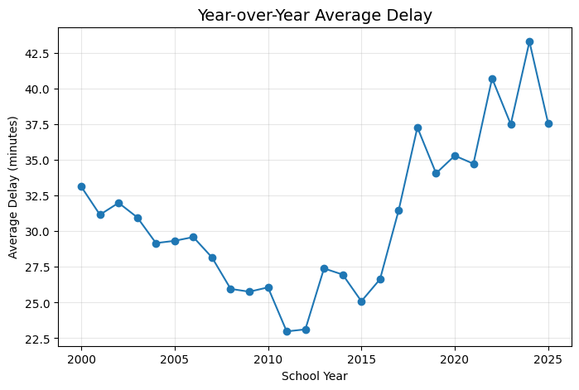
Year over Year Trend
Figure 3. Year-over-Year Average Delay:
Delays increased after 2016 by approx. 20 minutes.
Indicates growing traffic congestion and improved data reporting over time

Slide 11
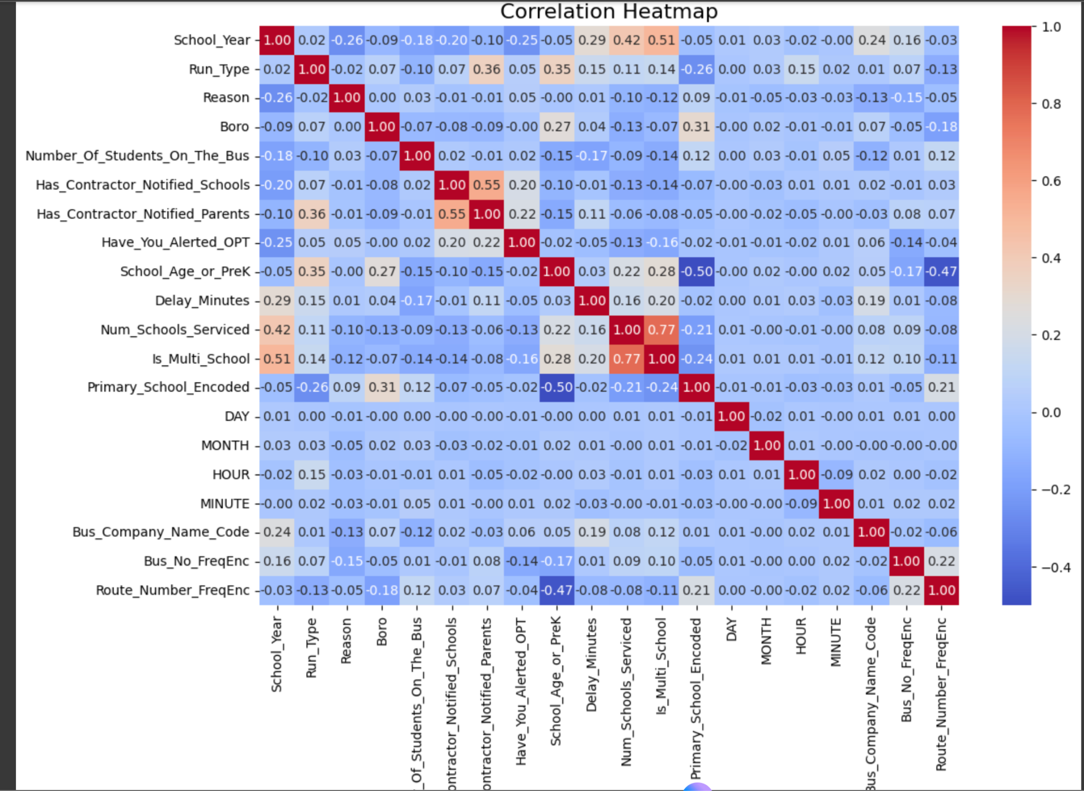
Correlation Heatmap
 | Ehab – Genetic Biomarkers
Figure 4. Heatmap:
Delay_Minutes strongly correlated with Delay_Class (approx. 0.88).
Weak relationship between Number_of_Students and delays.
Temporal features moderately influence delay

Slide 12
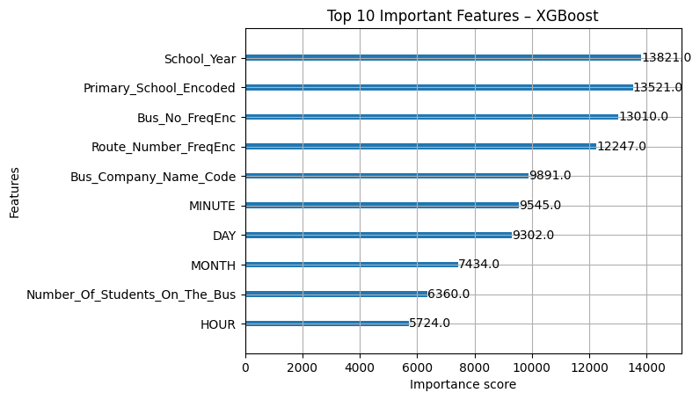
Feature Importance
Figure 5. Top Influencing Features:
School Year, Bus Company, Route Frequency
Conclusion: Both operational and temporal features determine delay likelihood

Slide 13
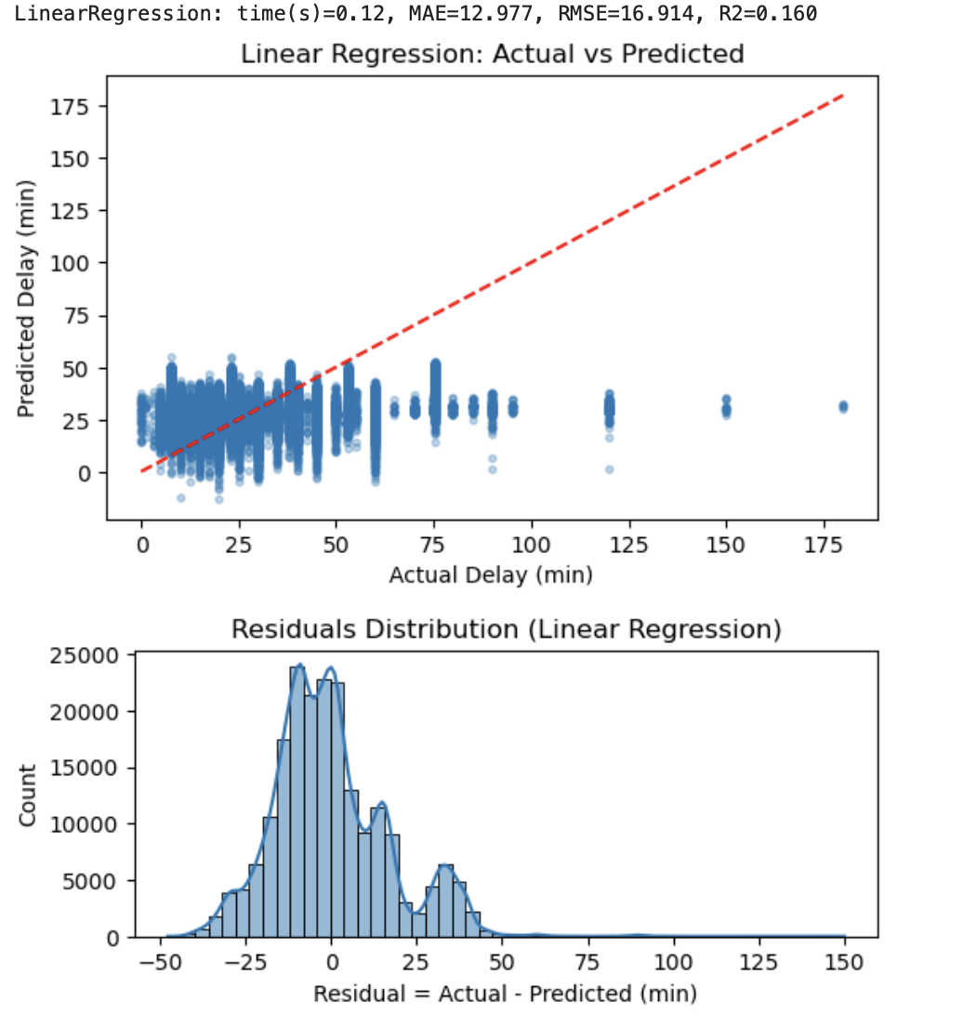
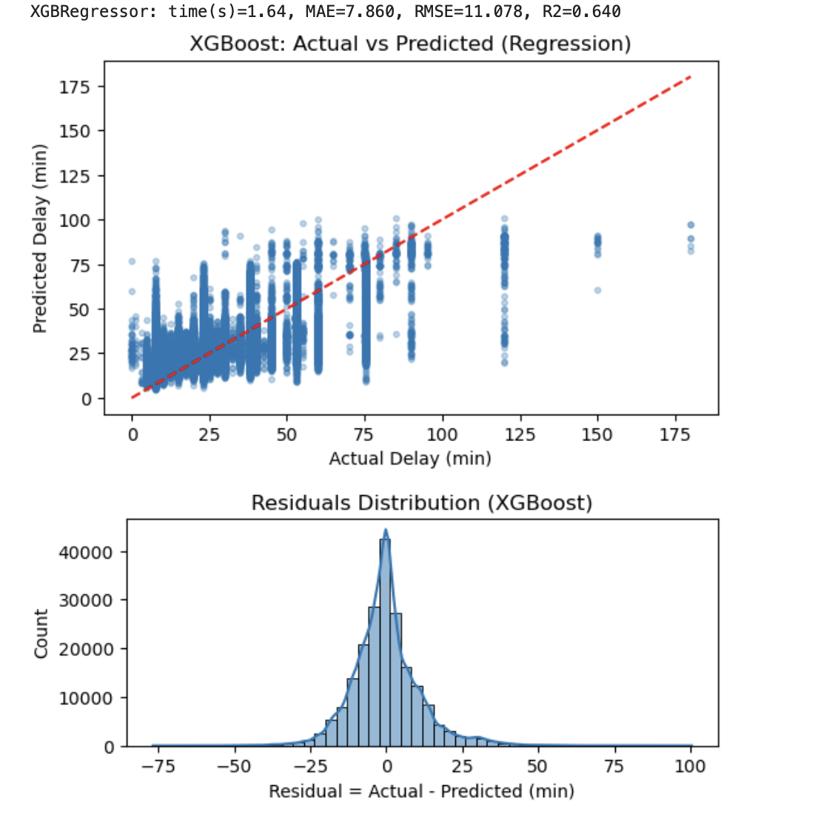
Model Designing
Type | Algorithm | Purpose | Evaluation Metrics
Regression | Linear Regression, XGBoostRegressor | Predict delay duration | MAE, RMSE, R²
Classification | Logistic Regression, XGBoostClassifier | Classify delay severity | Accuracy, Precision, Recall, F1
Metric | Linear Regression | XGBoost Regressor
MAE | 12.98 min | 7.86 min
RMSE | 16.91 min | 11.08 min
R² | 0.16 | 0.64
Training Time | 0.12 s | 1.66 s
Error reduced drastically: MAE fell from ~13 → ~8 minutes.
Model fit improved: R² jumped from 0.16 → 0.64, meaning the XGBoost explains 64% of delay variance — a 4x improvement.
Residual plot: Centered tightly around zero → fewer large mispredictions.
Scatter plot: Points much closer to the red diagonal → higher predictive accuracy.

Slide 14
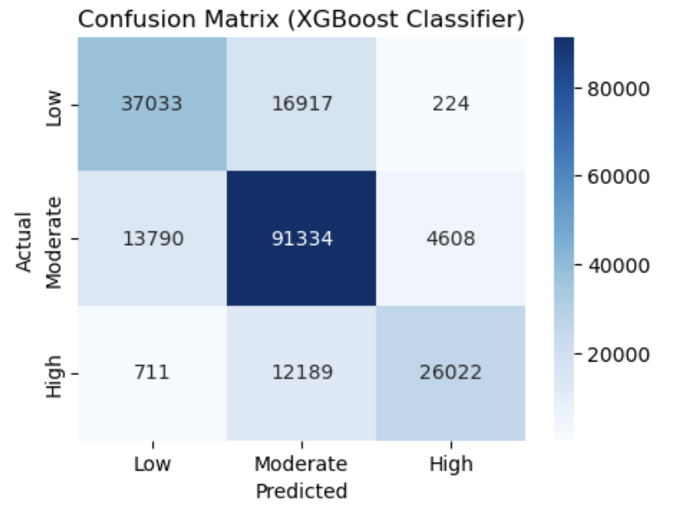
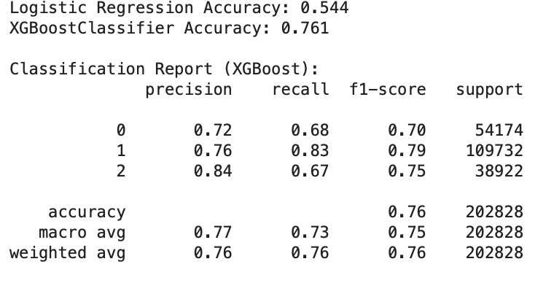
Classification Results
Logistic Regression:
Accuracy: 54%
Struggled to separate Moderate vs High delays.
XGBoost Classifier:
Accuracy: 76%
Precision: 0.76, Recall: 0.73, F1: 0.75
Handles non-linear delay factors effectively.
Major confusion only between Low and Moderate categories.

Slide 15
Project Management and Proposed Model

Slide 16
Key Insights
1. Operational Insights
Delays are right-skewed, with most incidents between 20–45 minutes.
Manhattan, Queens, and Rockland County show the highest average delays (~35–36 mins).
Delays increased sharply post-2016 (likely due to traffic congestion and reporting consistency).
Number of schools serviced and bus company are key contributors to delay variation.
2. Model Insights
Regression Task (XGBoost Regressor)
Achieved R² = 0.64, explaining 64% of delay duration variance.
Reduced MAE by ~40% (13 → 8 mins) compared to Linear Regression.
Residuals tightly centered → fewer high-error predictions.
Classification Task (XGBoost Classifier)
Achieved 76% accuracy, outperforming Logistic Regression by 22%.
High delays (critical events) detected with 83% recall.
Major confusion only between Low and Moderate delays which is acceptable overlap range.
3. Strategic Implications
Data-driven delay predictions can enable preemptive routing and scheduling.
Borough-level and vendor-level insights support contract performance monitoring.
Integrating model outputs into a live dashboard can prioritize response efforts for chronic delays.

Slide 17
THANK YOU

